Slide 1

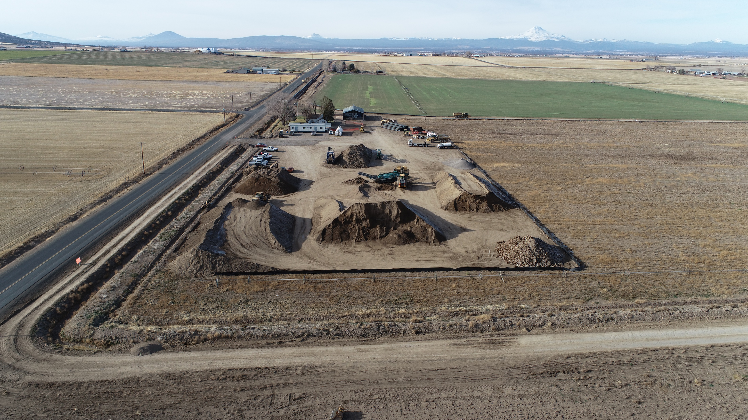

Nuid pIPE Project overview UAS flights 12/10/24
Flown by:
Shad R. Sitz
FAA 107 Cert# 4105497
44northaviation@gmail.com
541-588-0840

Slide 2
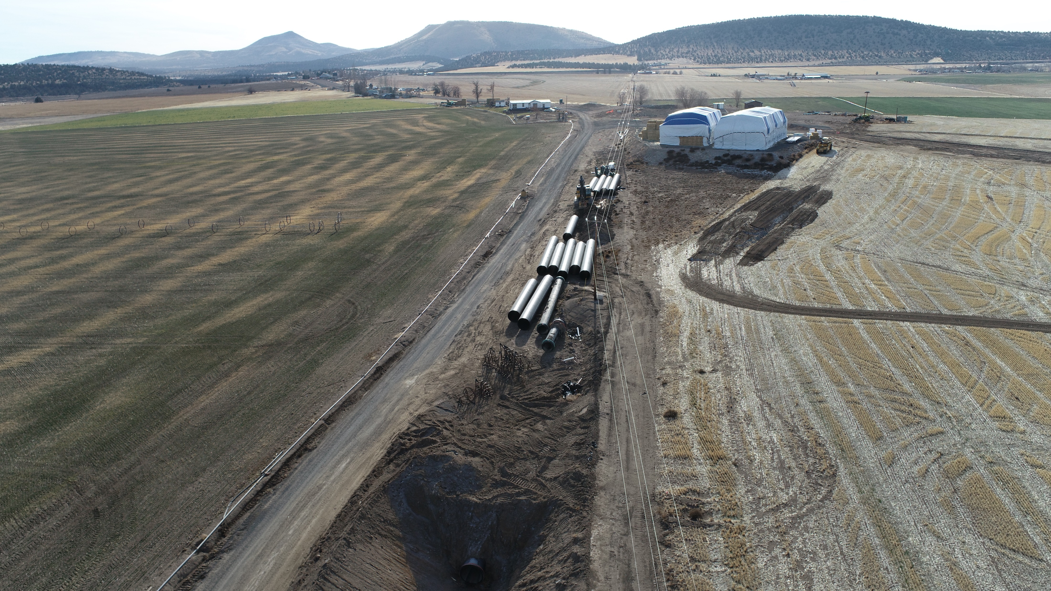
NUID 43 lateral Looking South

Slide 3
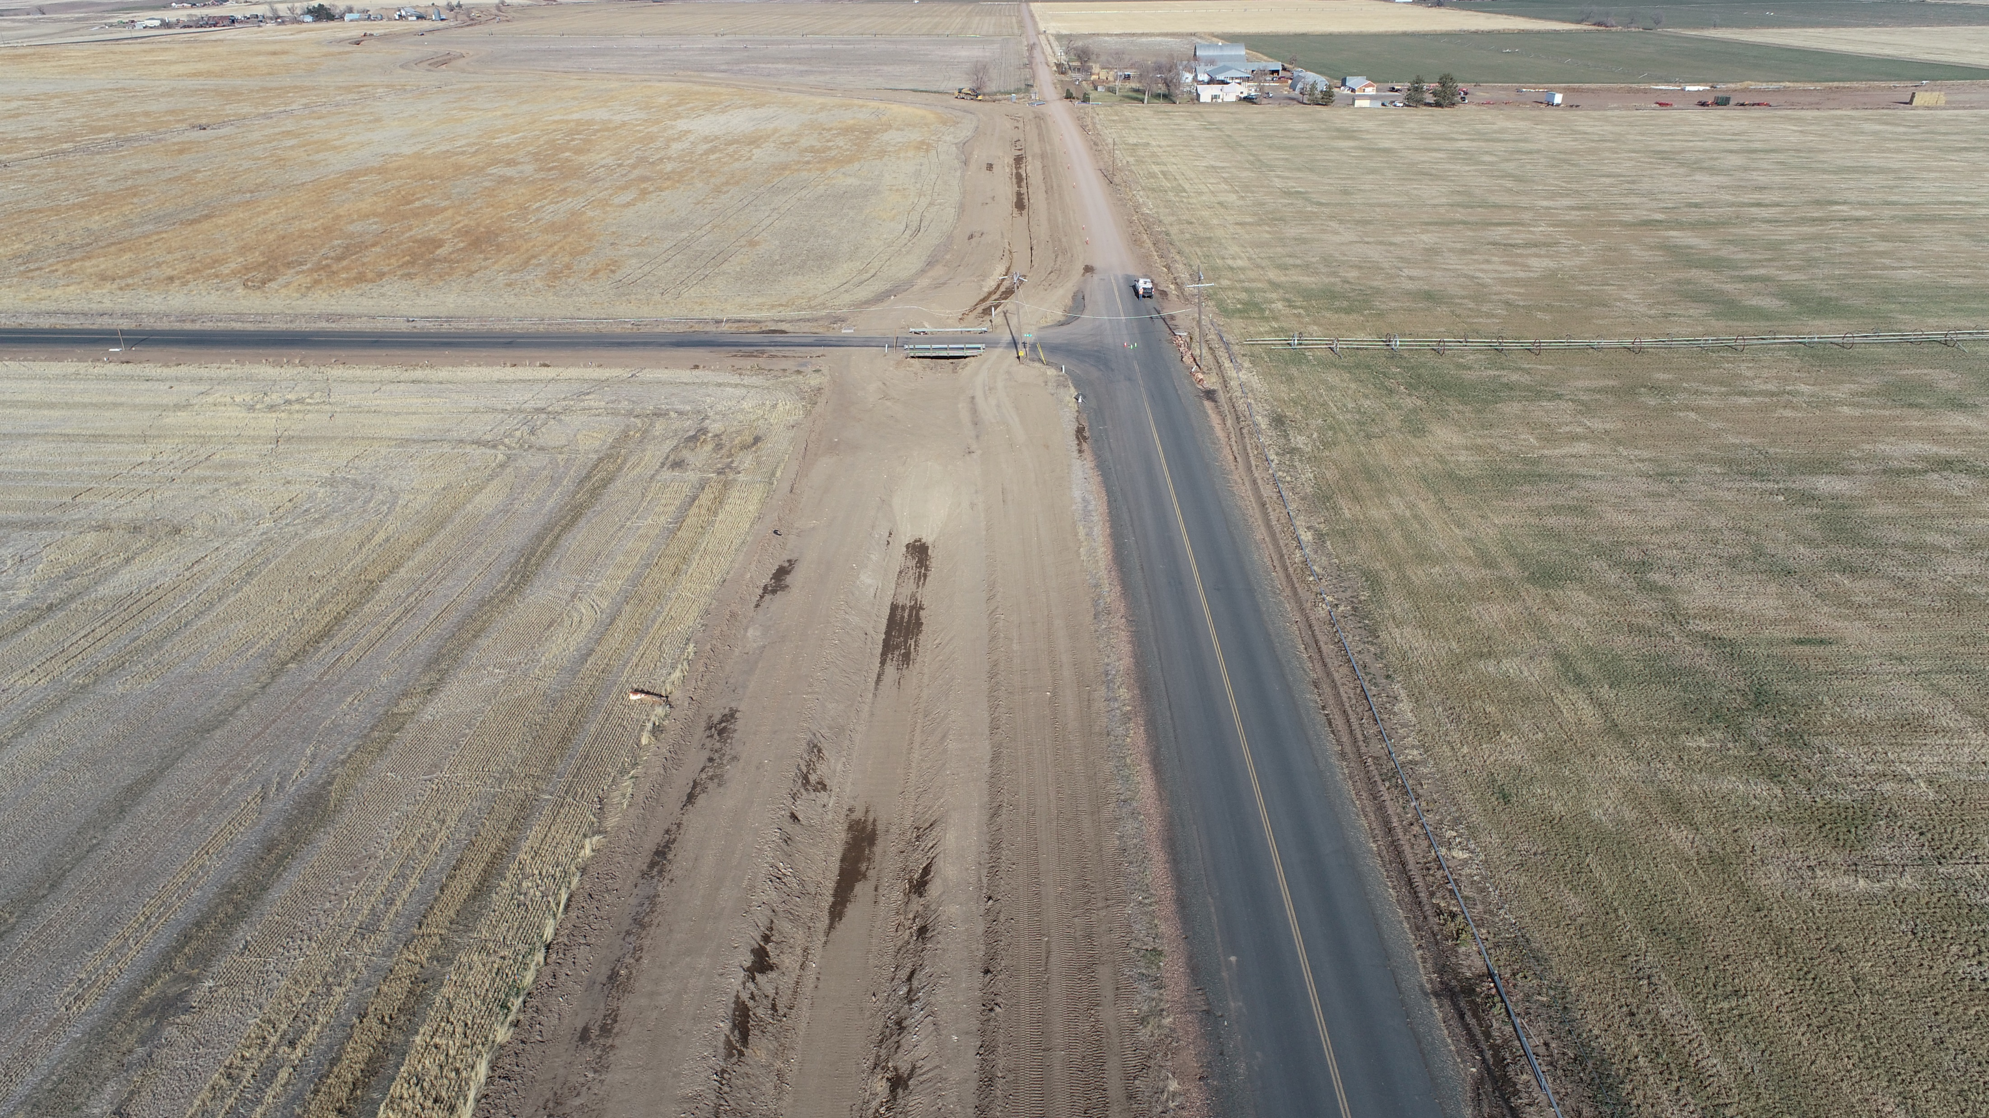
NUID 43 LATERAL Looking North

Slide 4
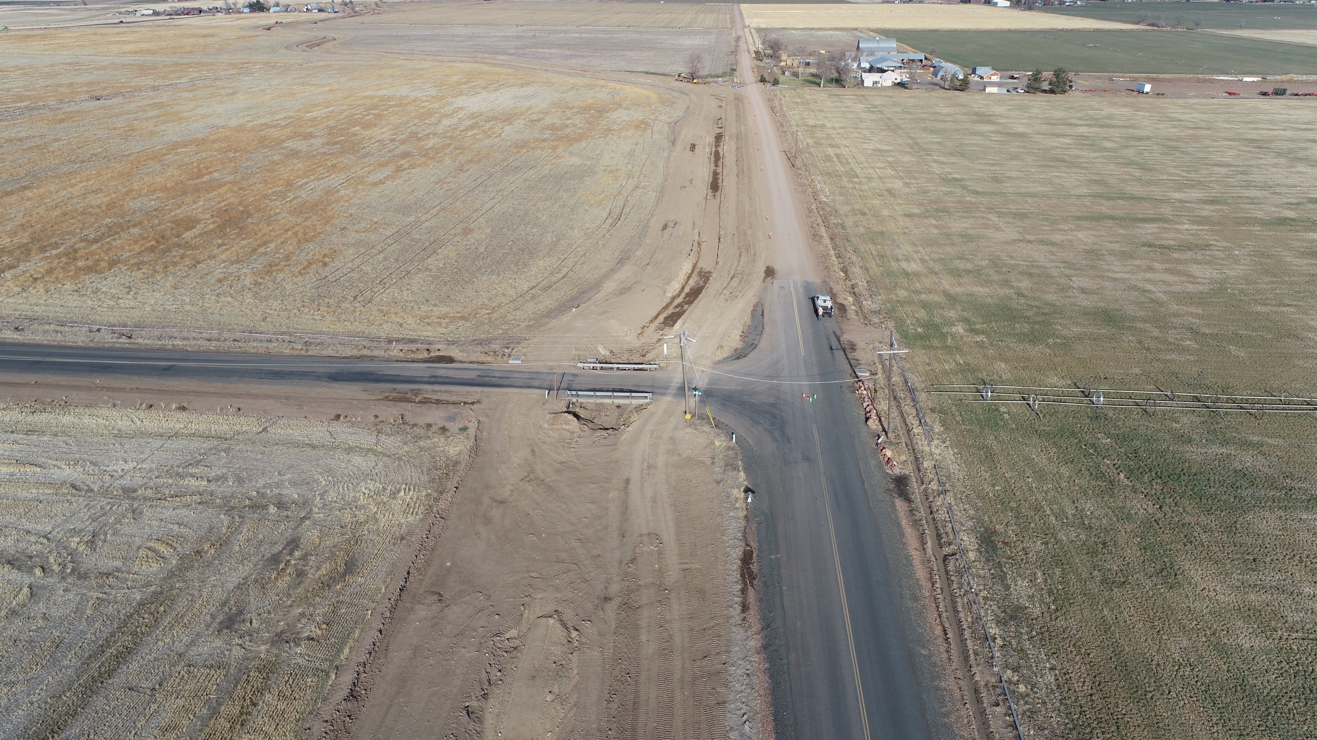

Slide 5
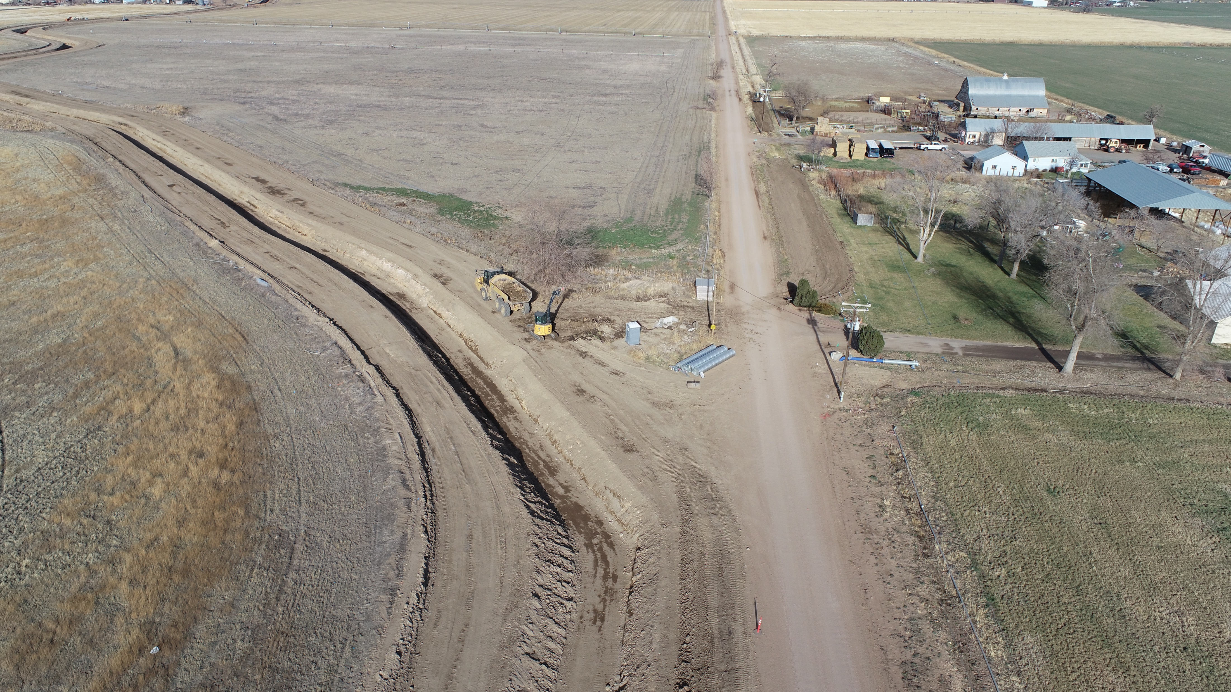

Slide 6
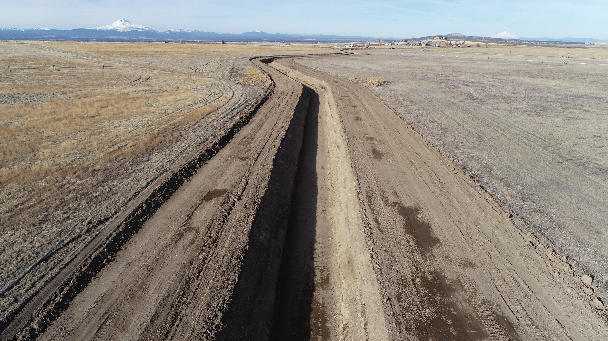

Slide 7
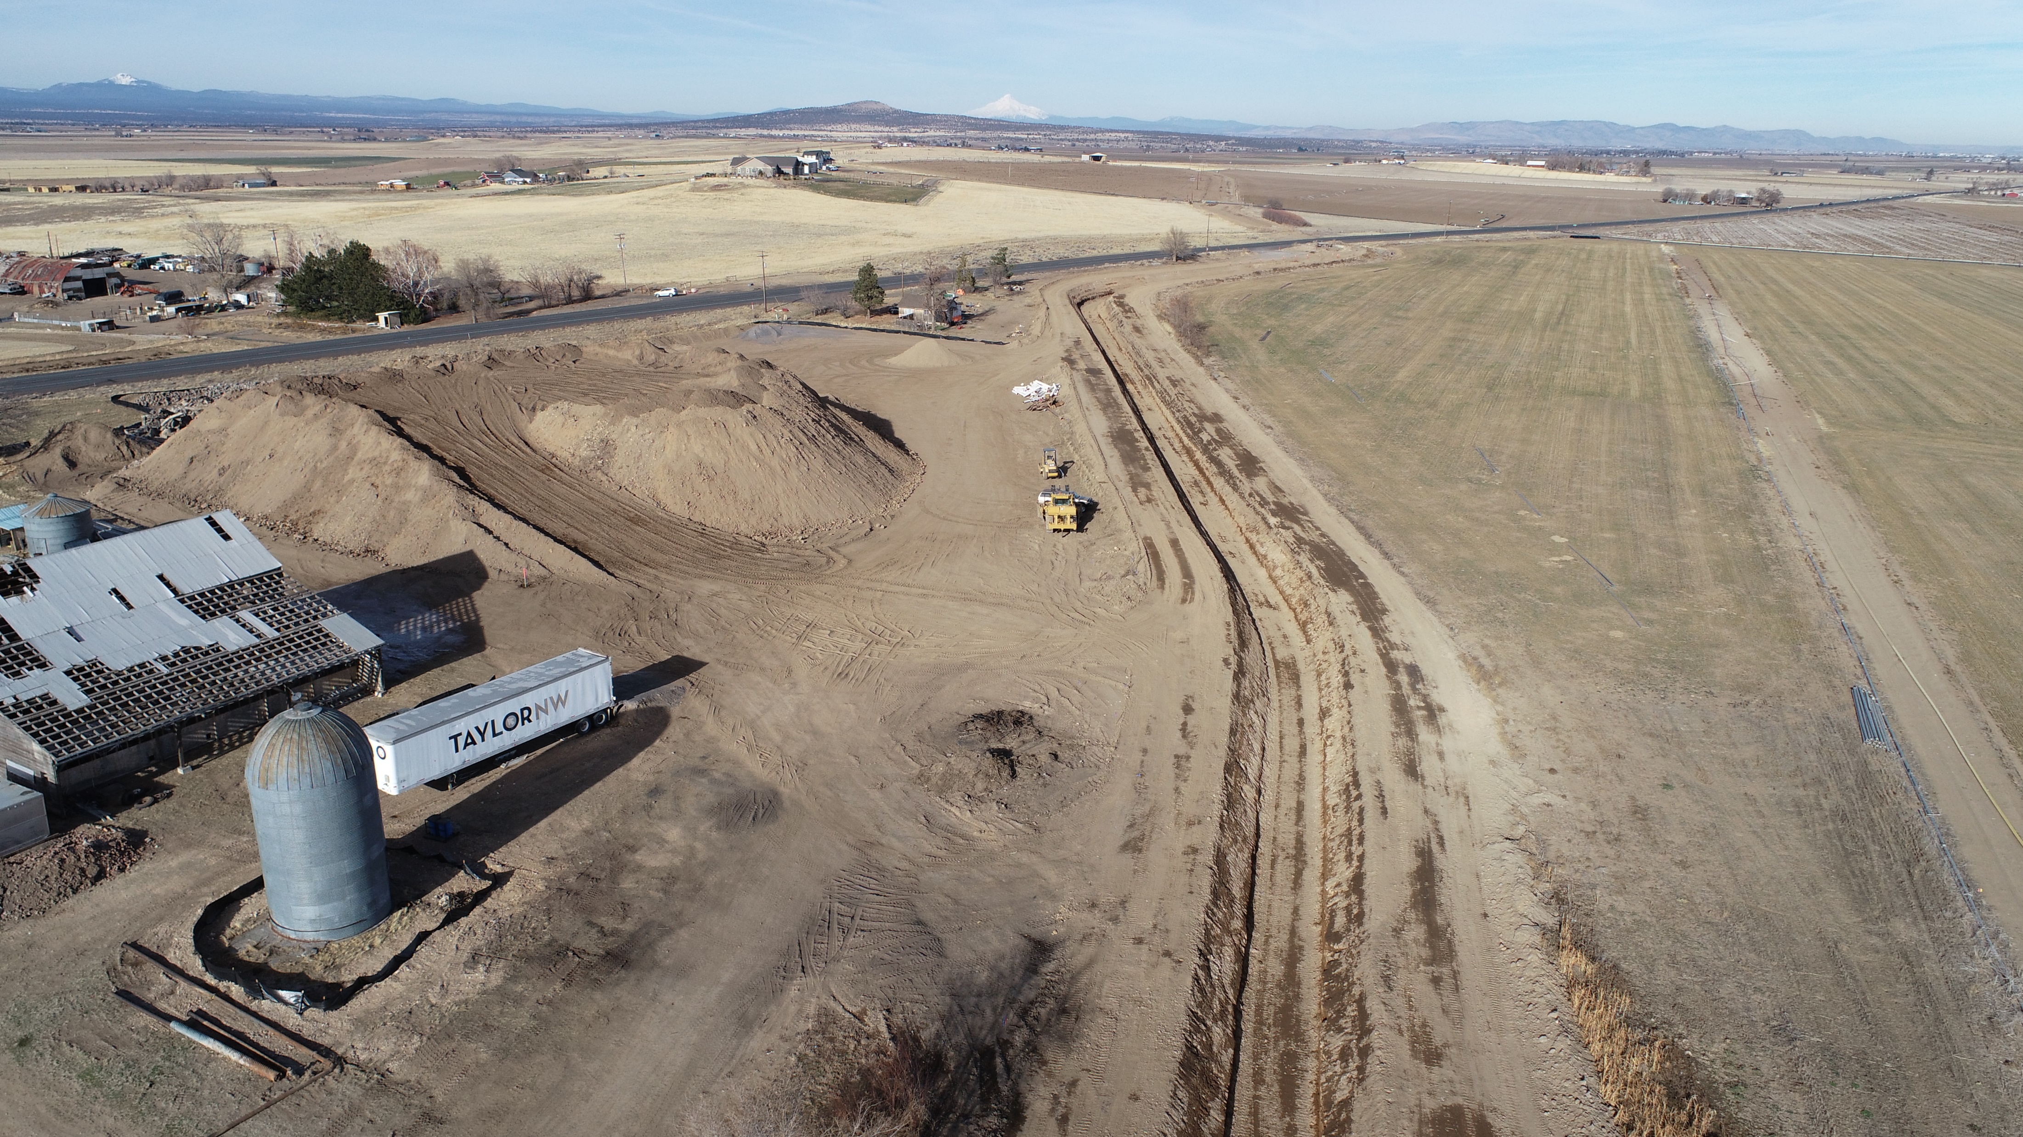

Slide 8
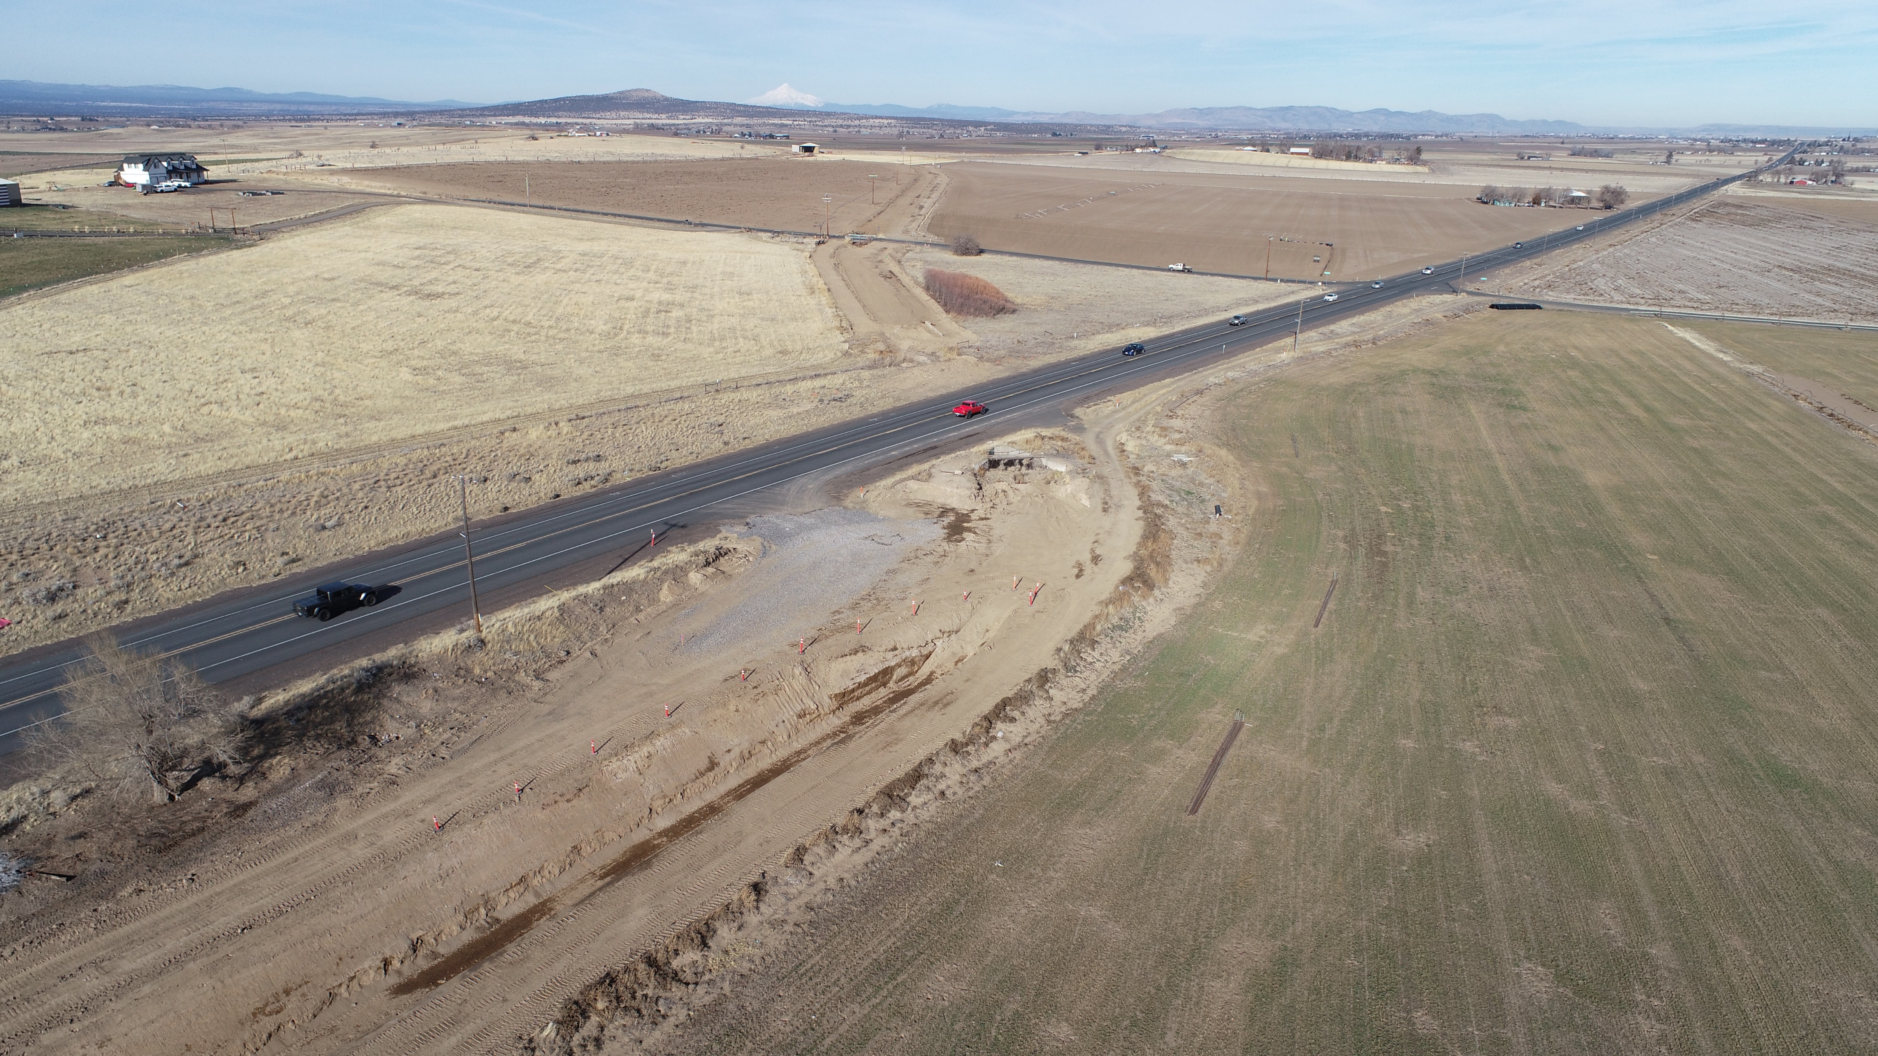

Slide 9
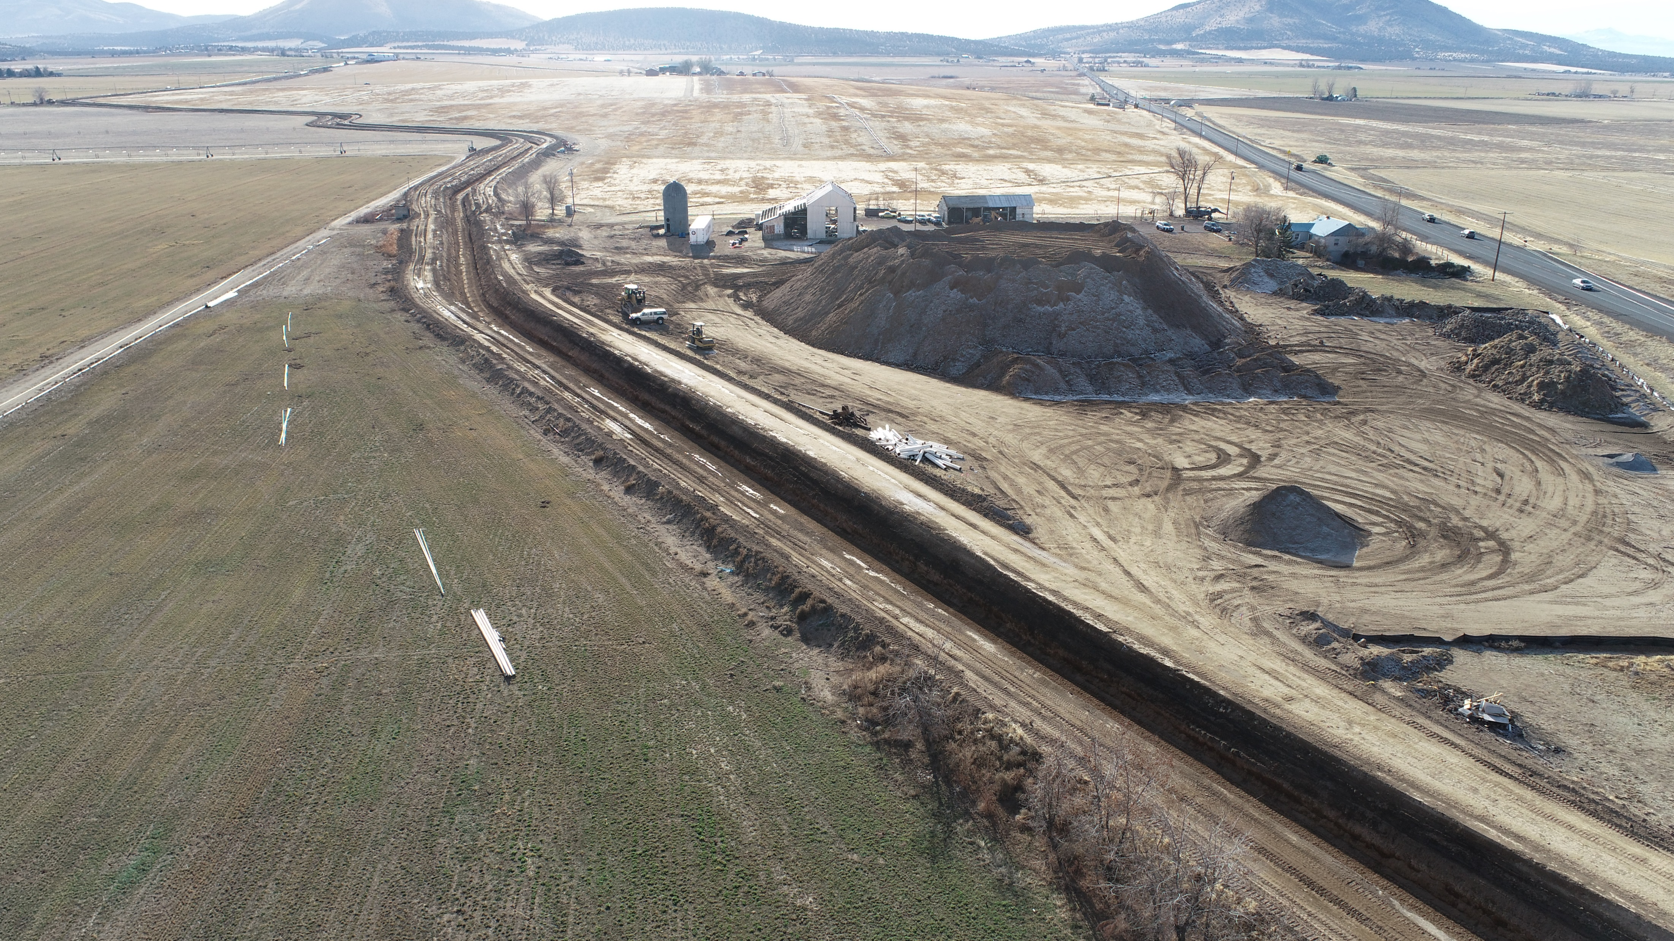

Slide 10
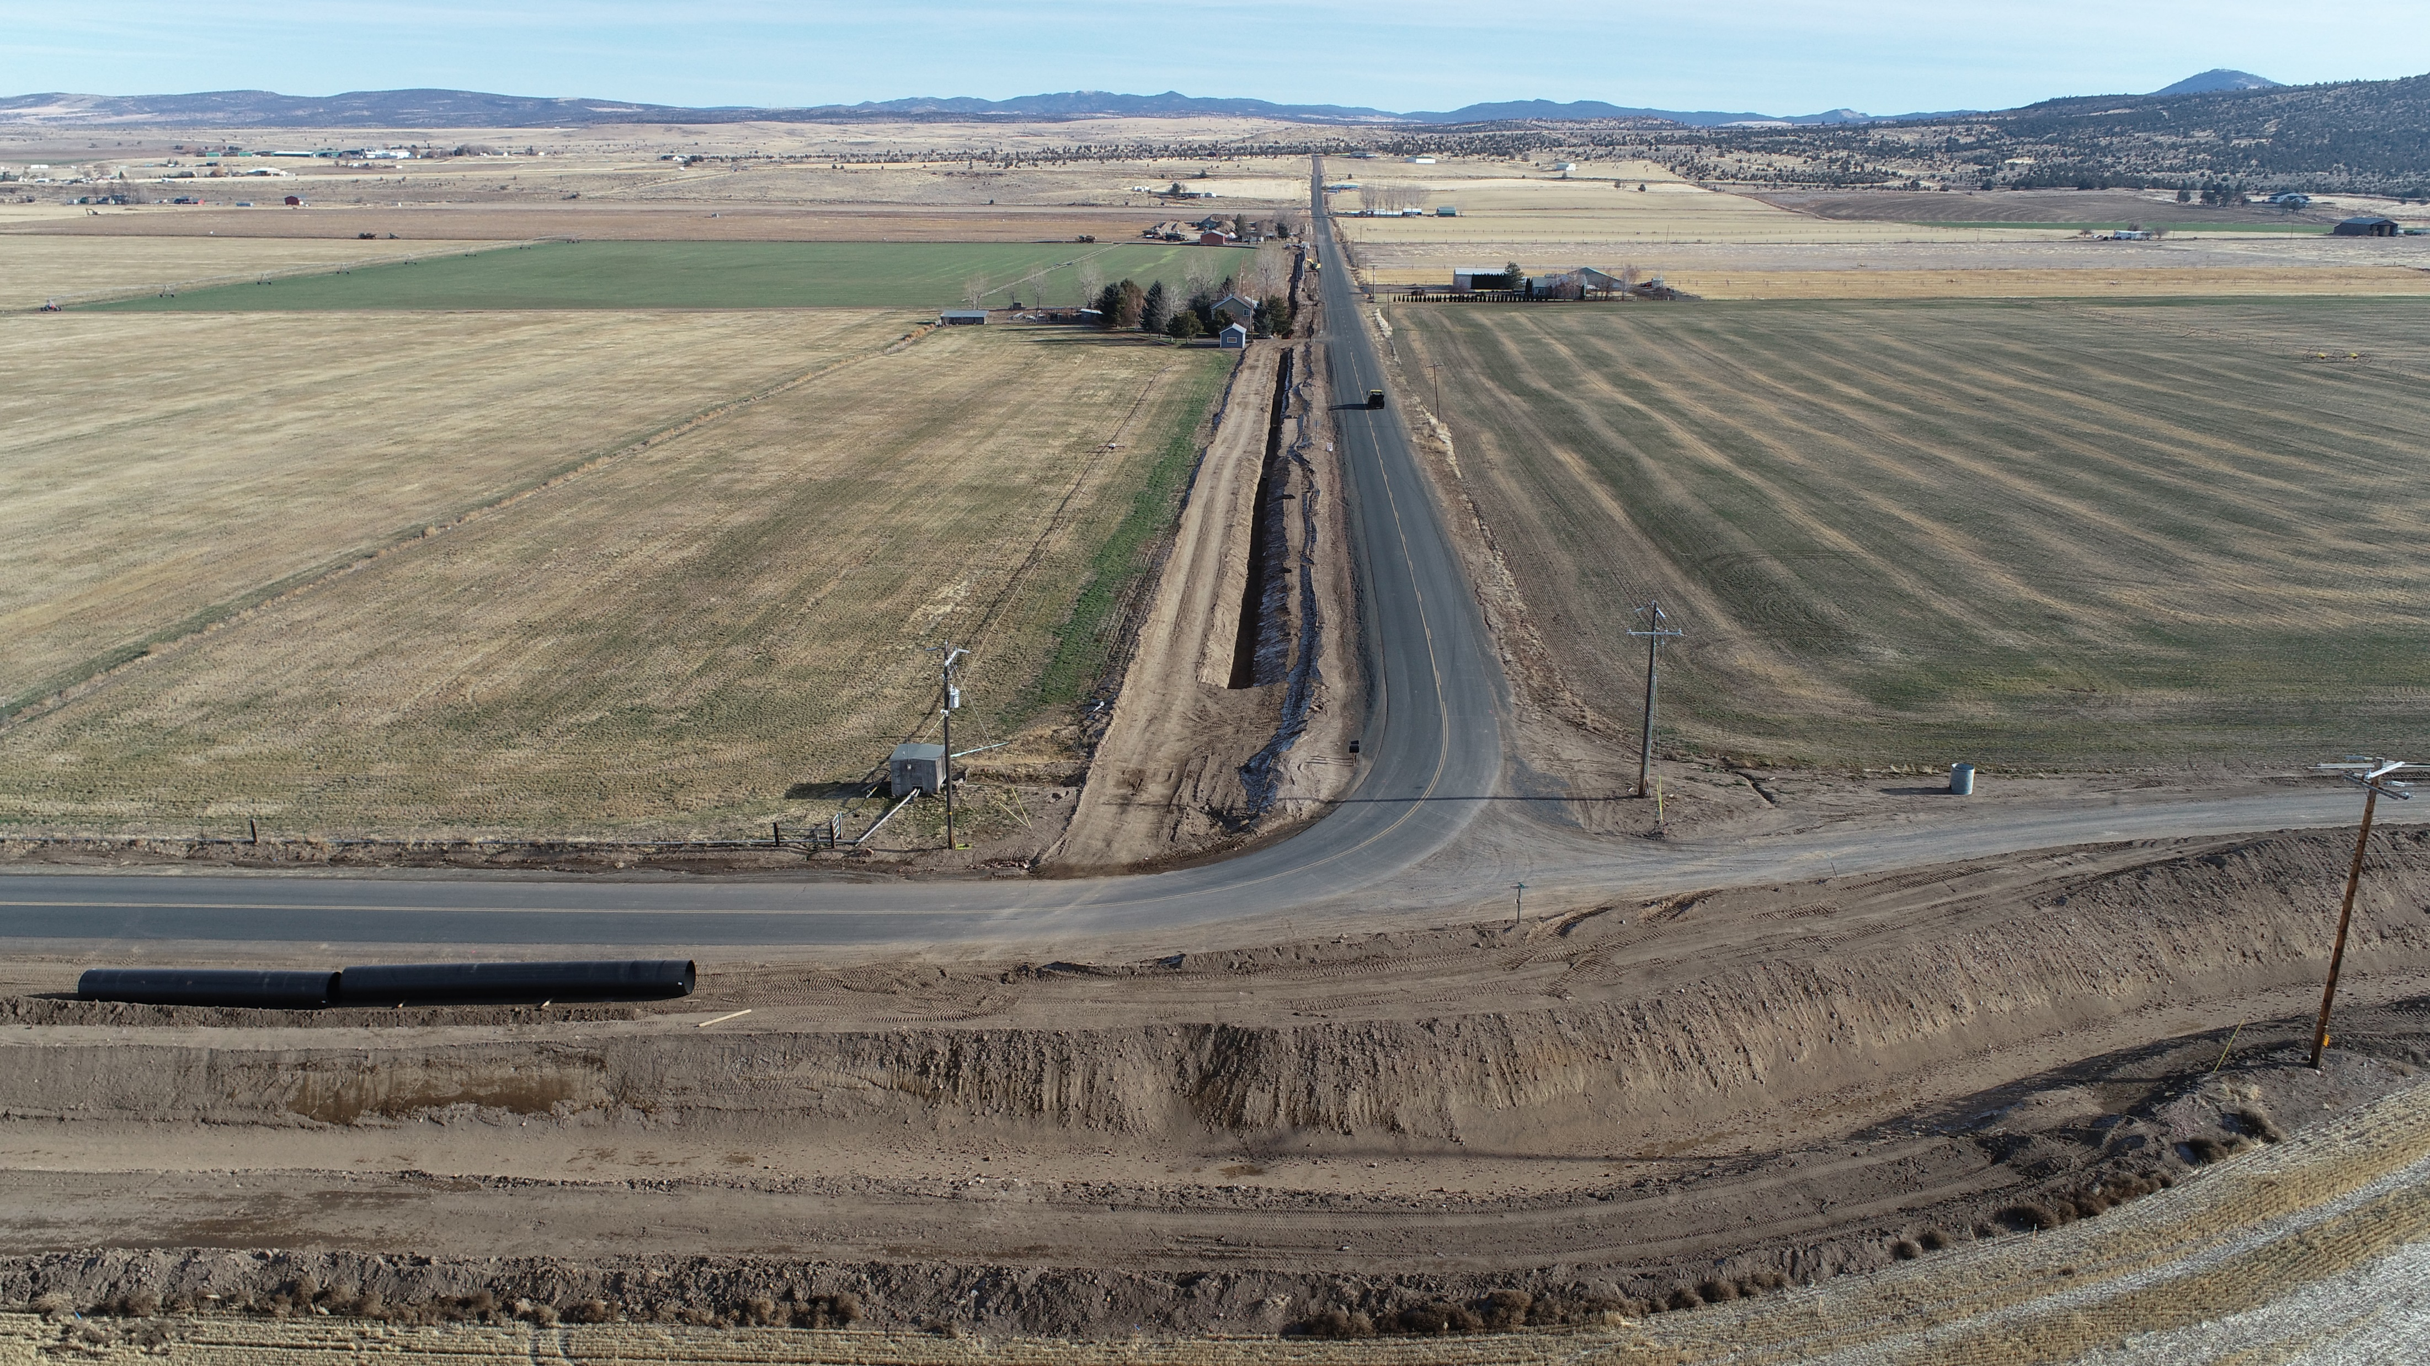
43 Blue and 43 -2 Purple intersection lateral looking East

Slide 11
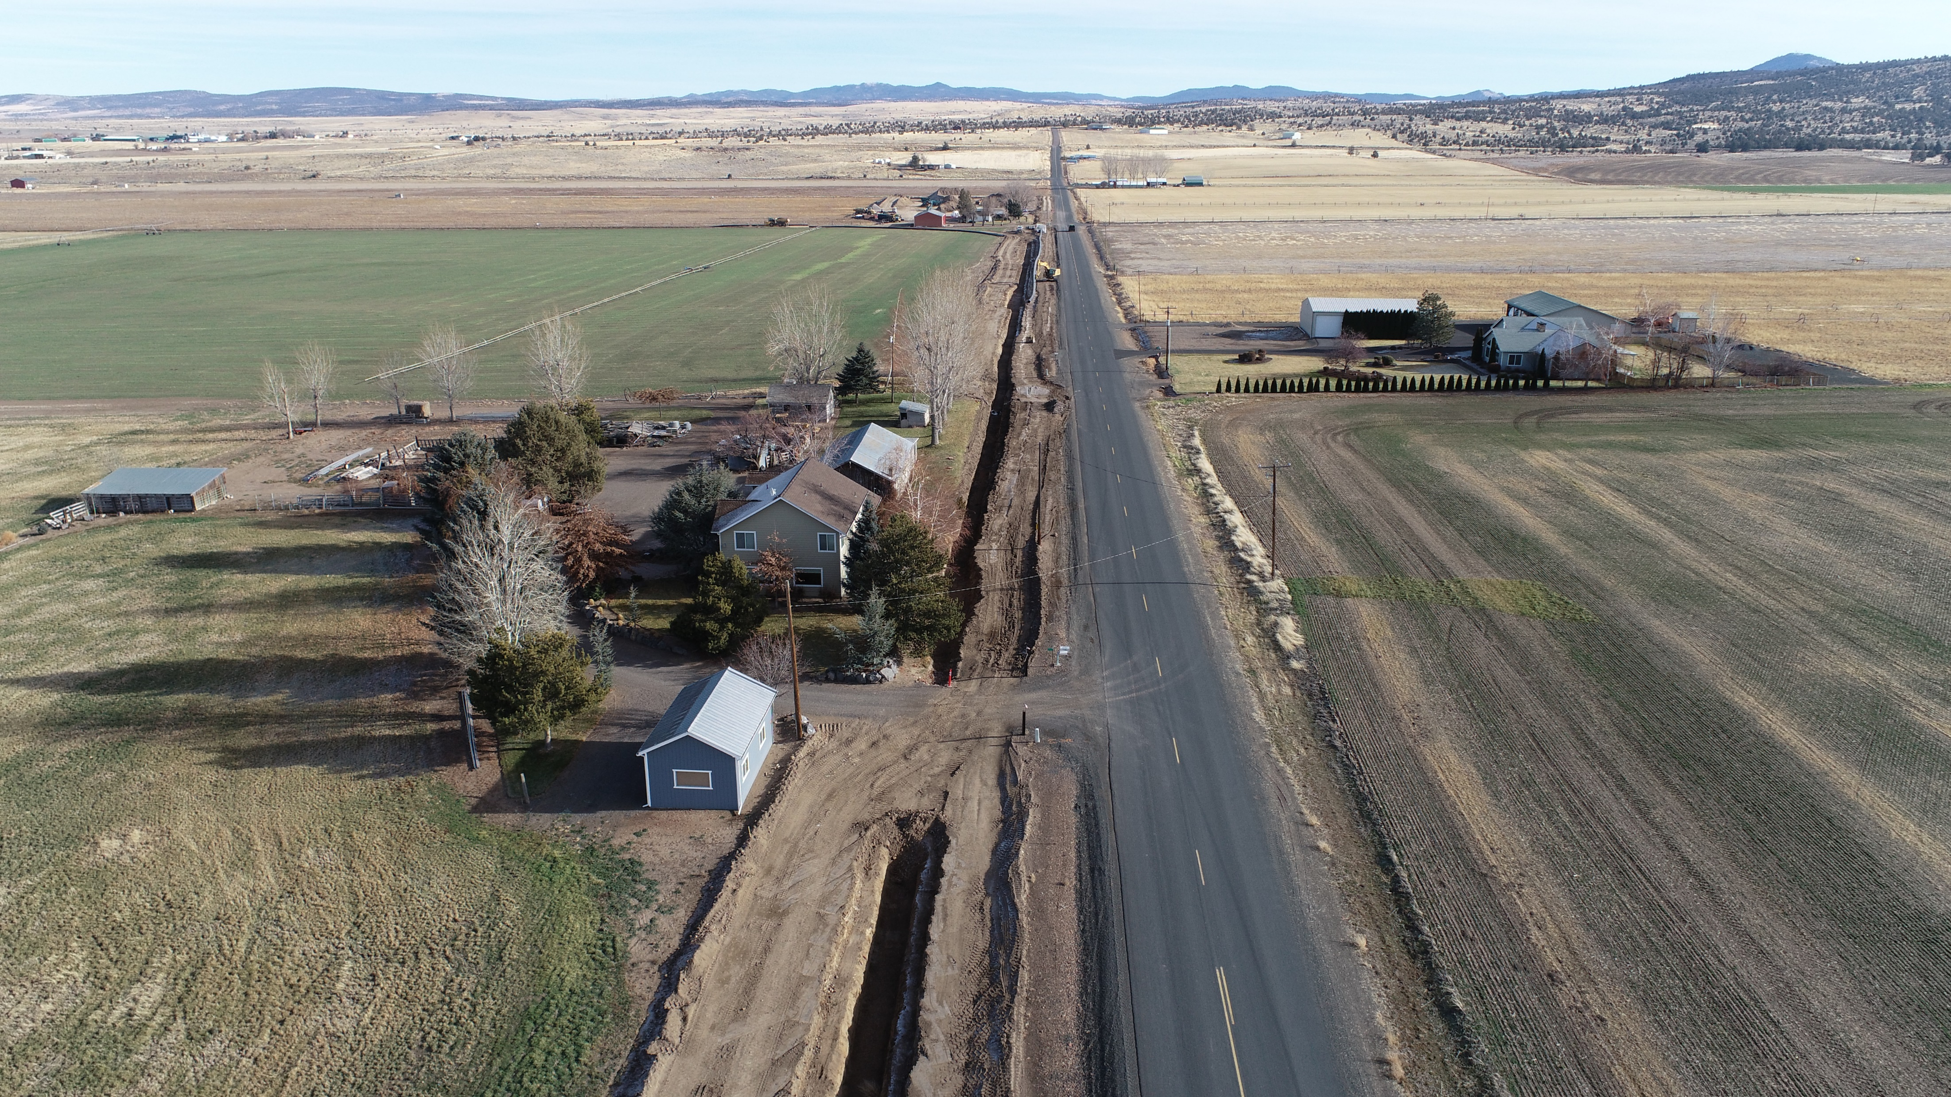

Slide 12
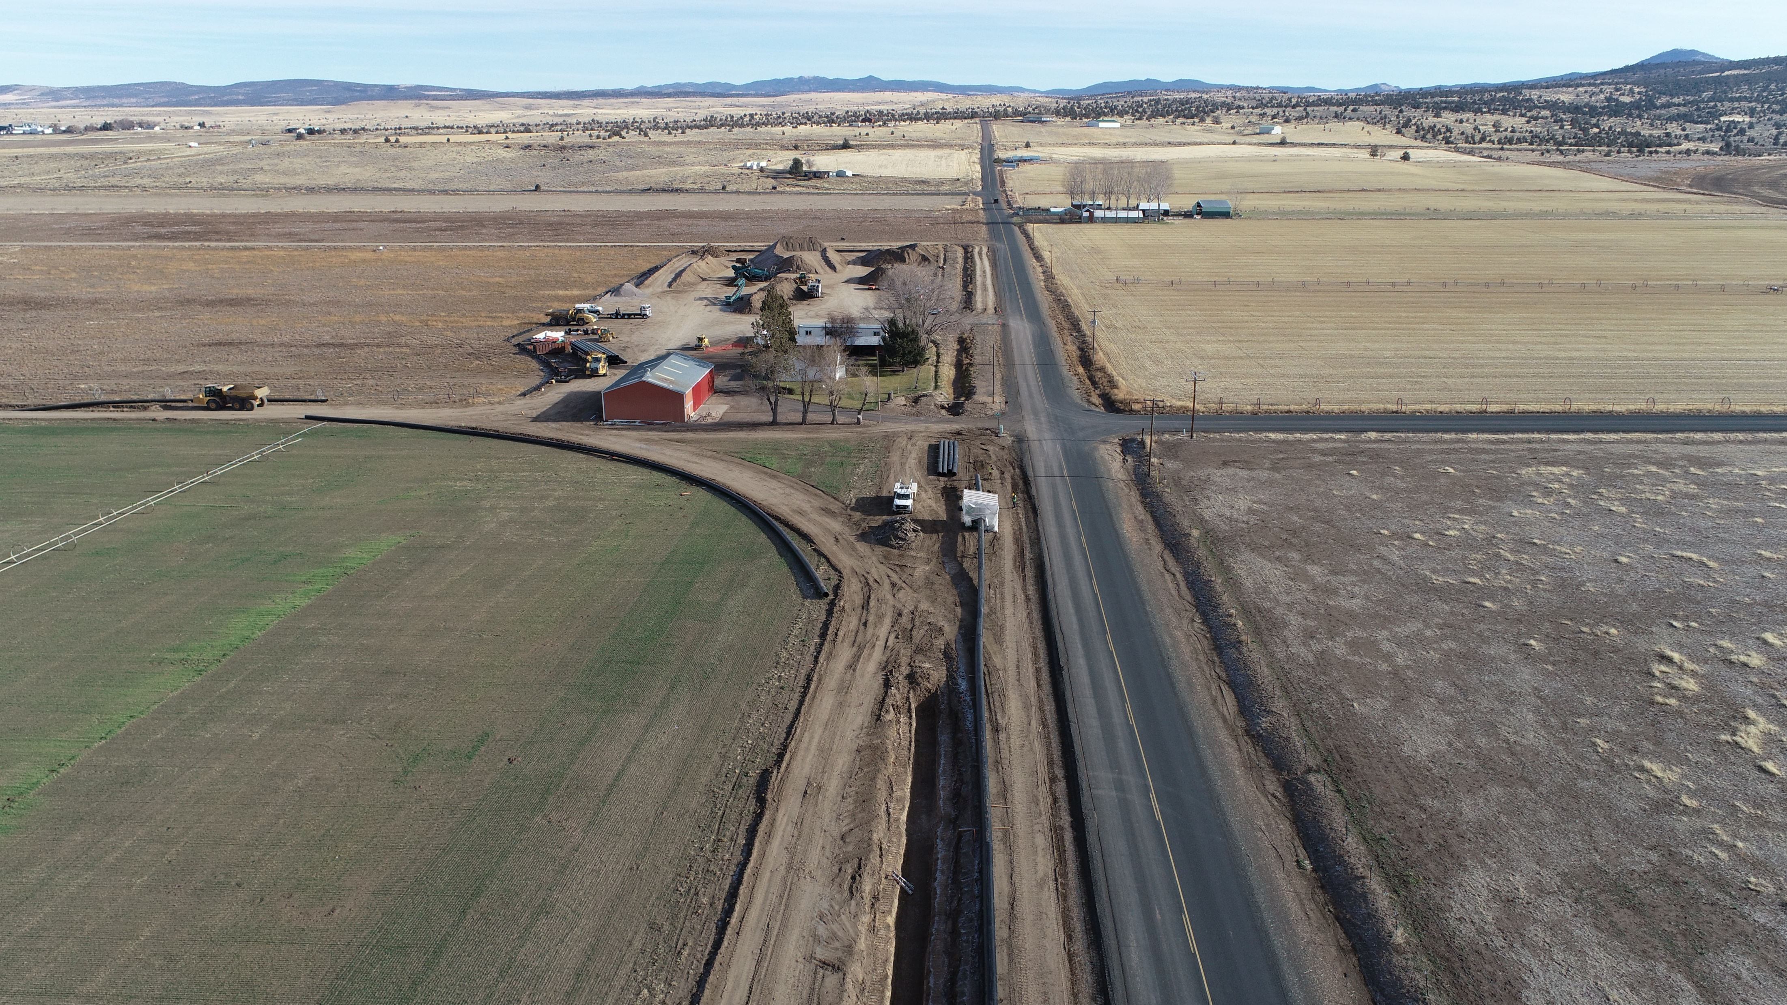
43-2 Purple Staging Area

Slide 13


Slide 14
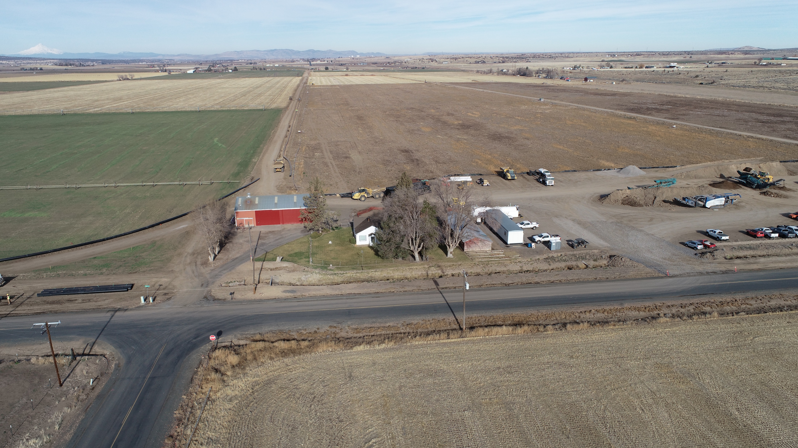

Slide 15
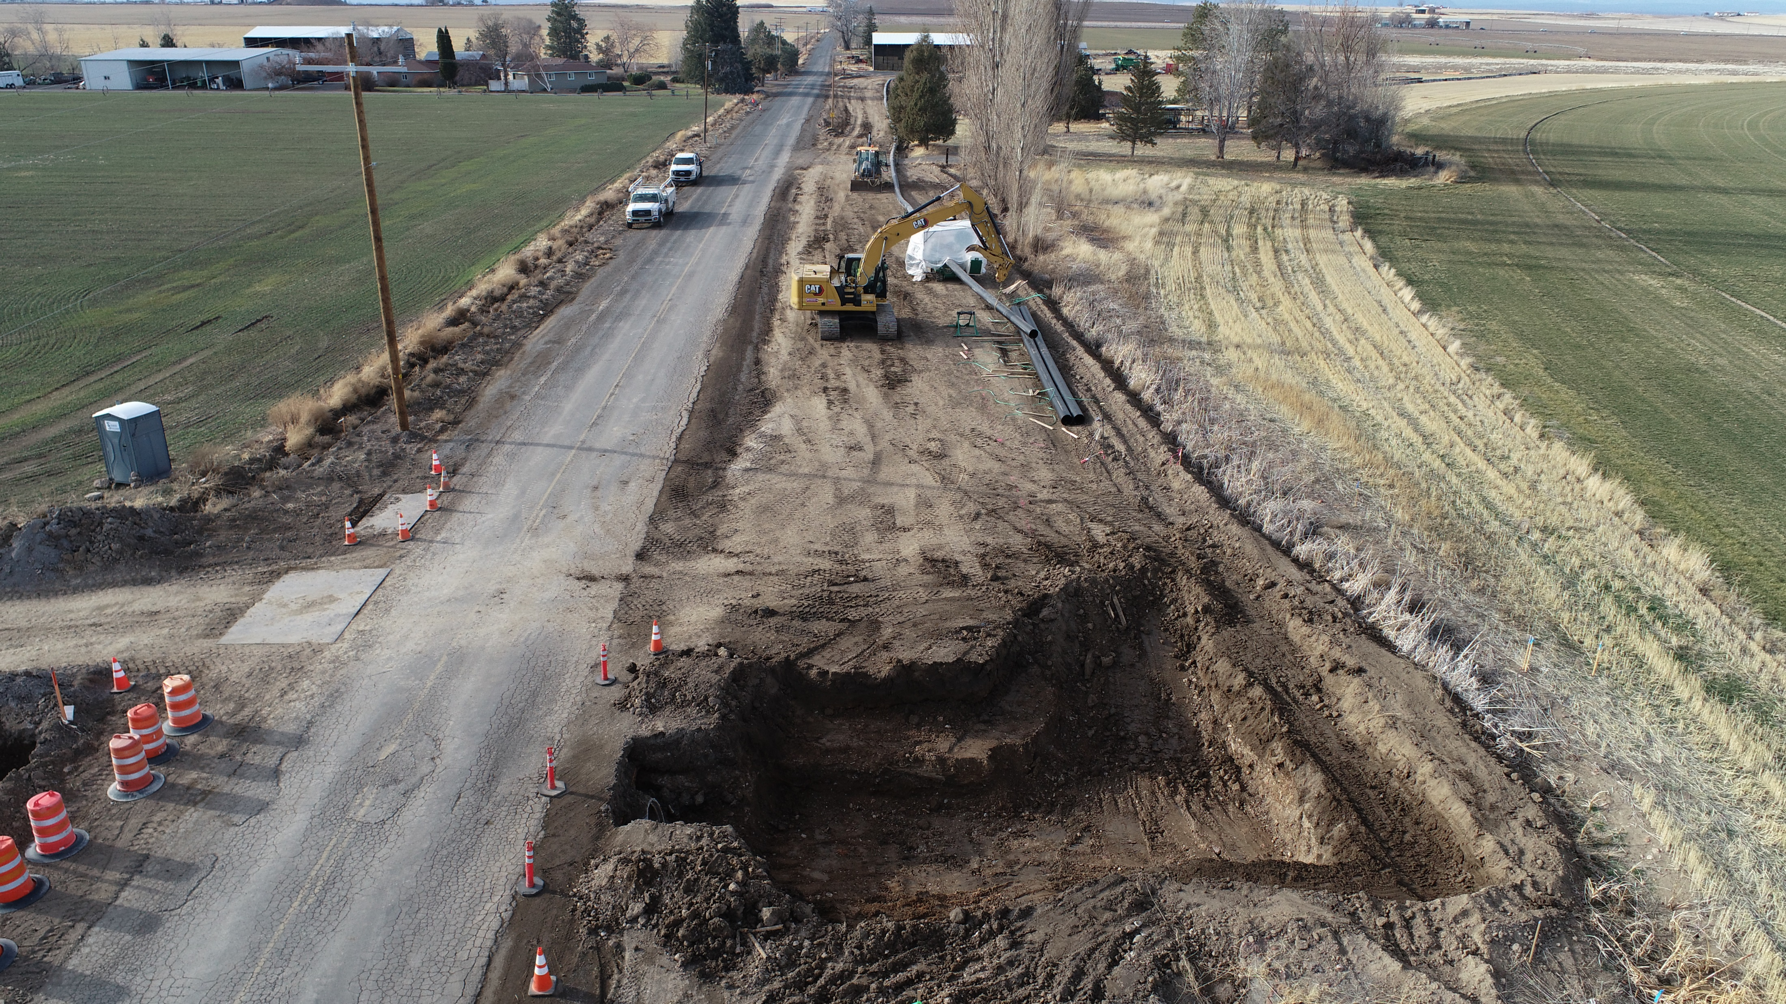
43-2 Lateral SW Highland Ln and Control 101

Slide 16
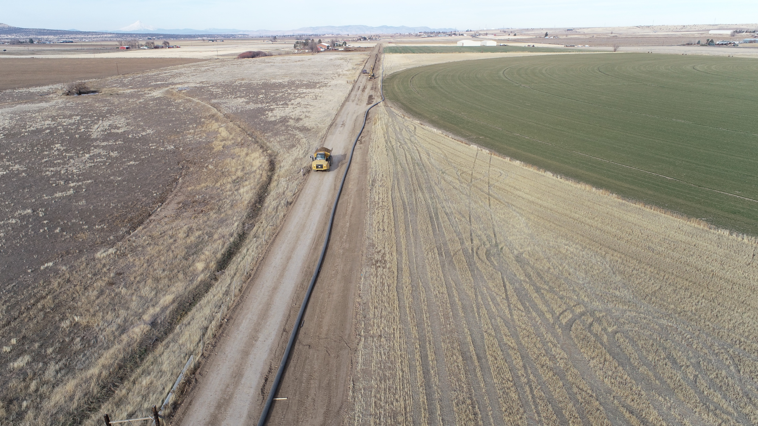

Slide 17
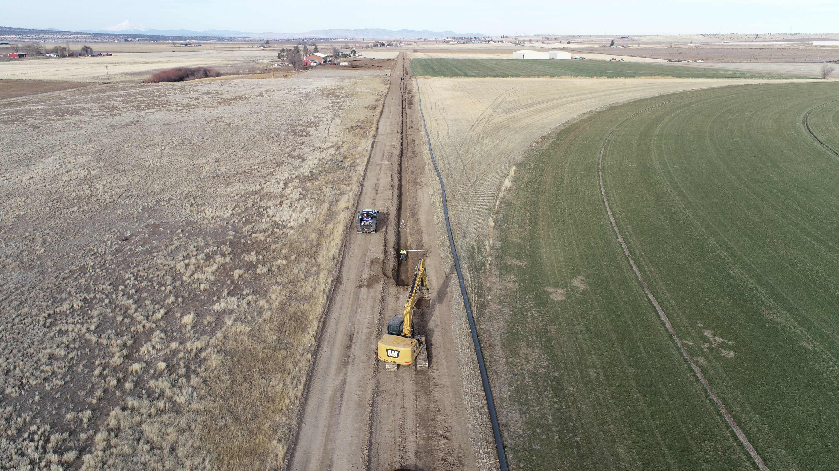

Slide 18
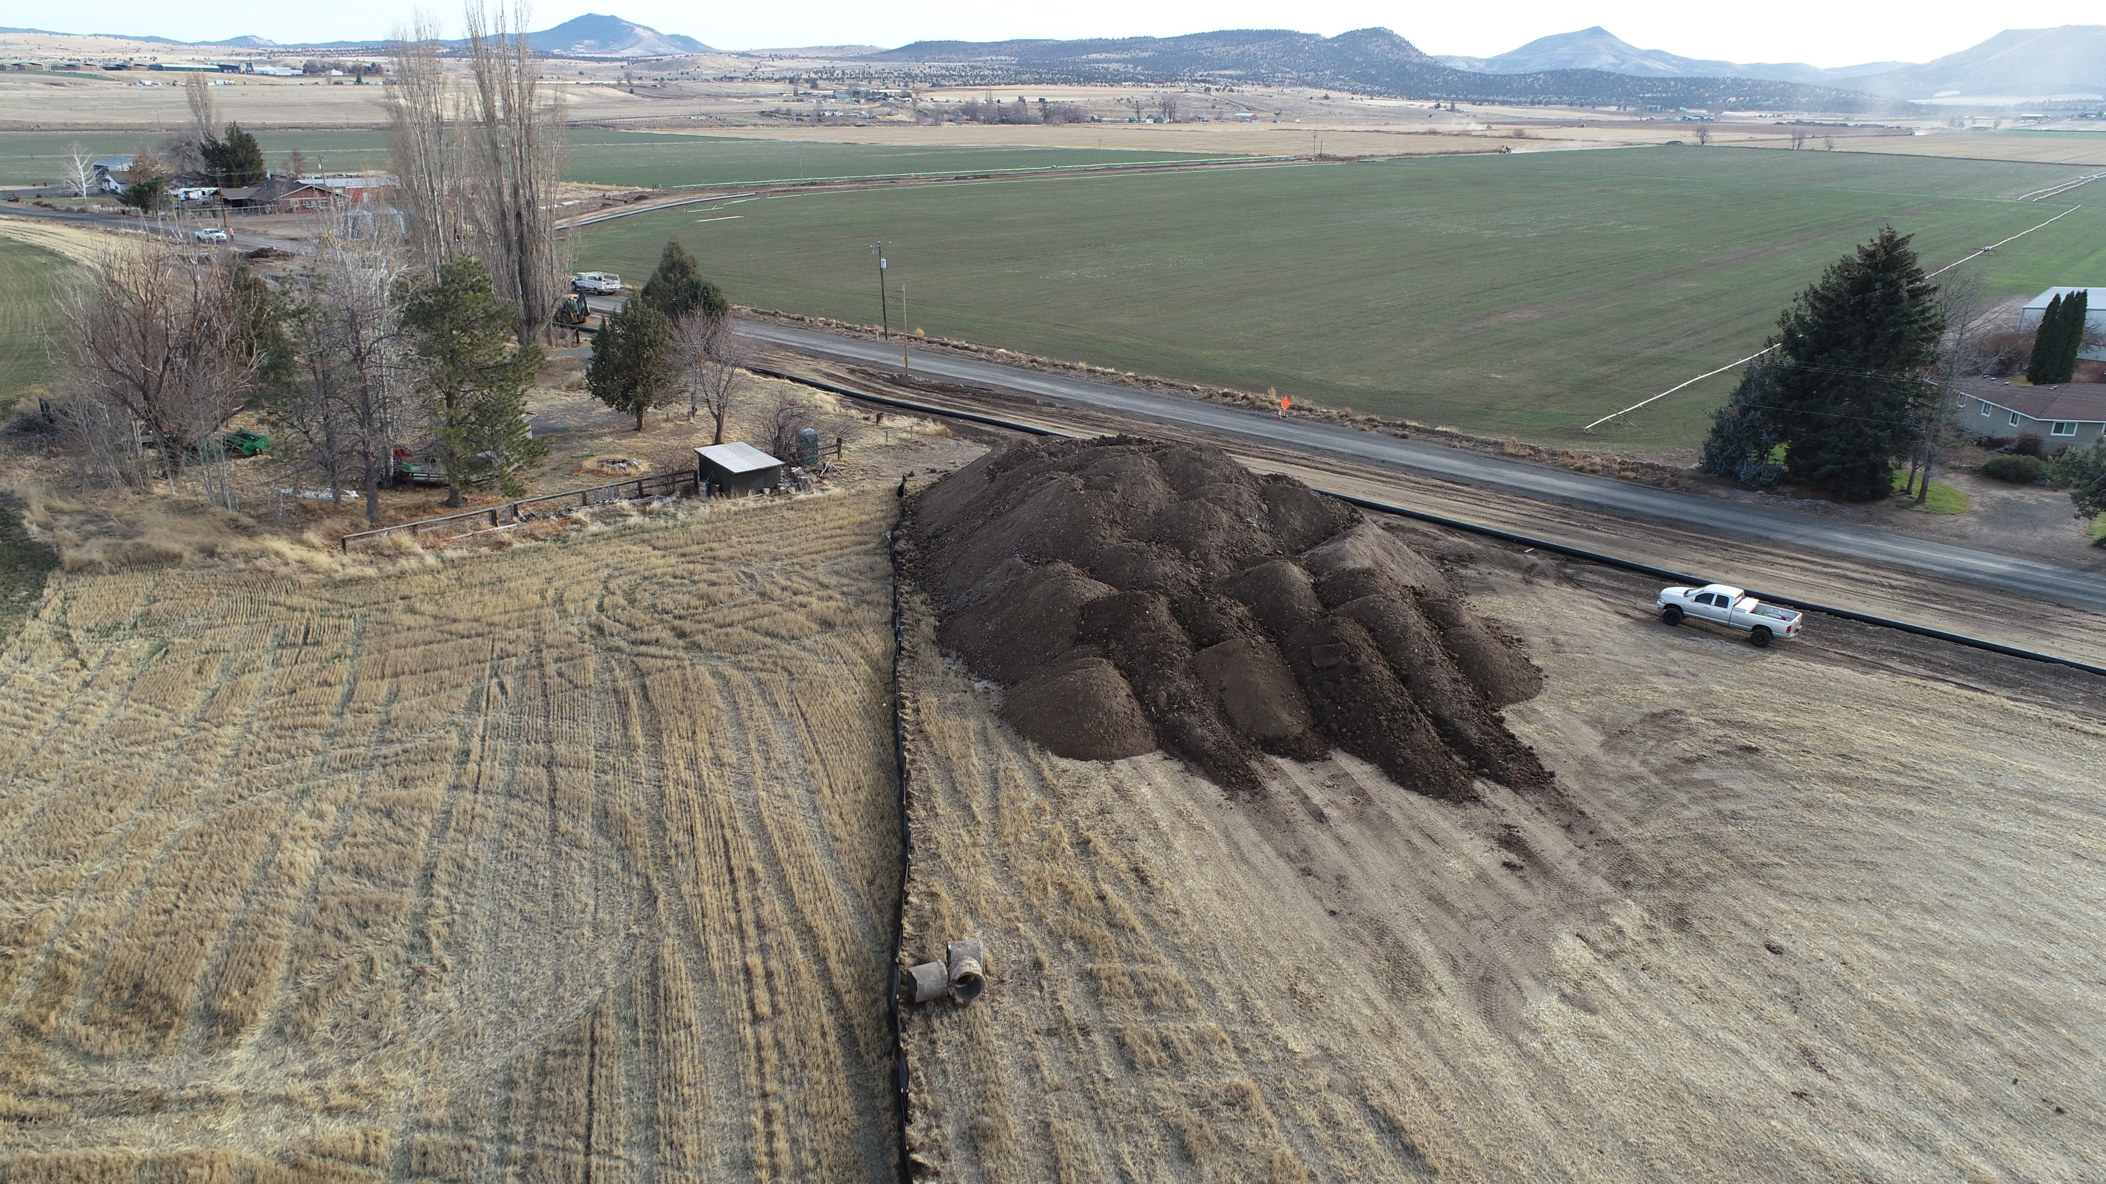

Slide 19
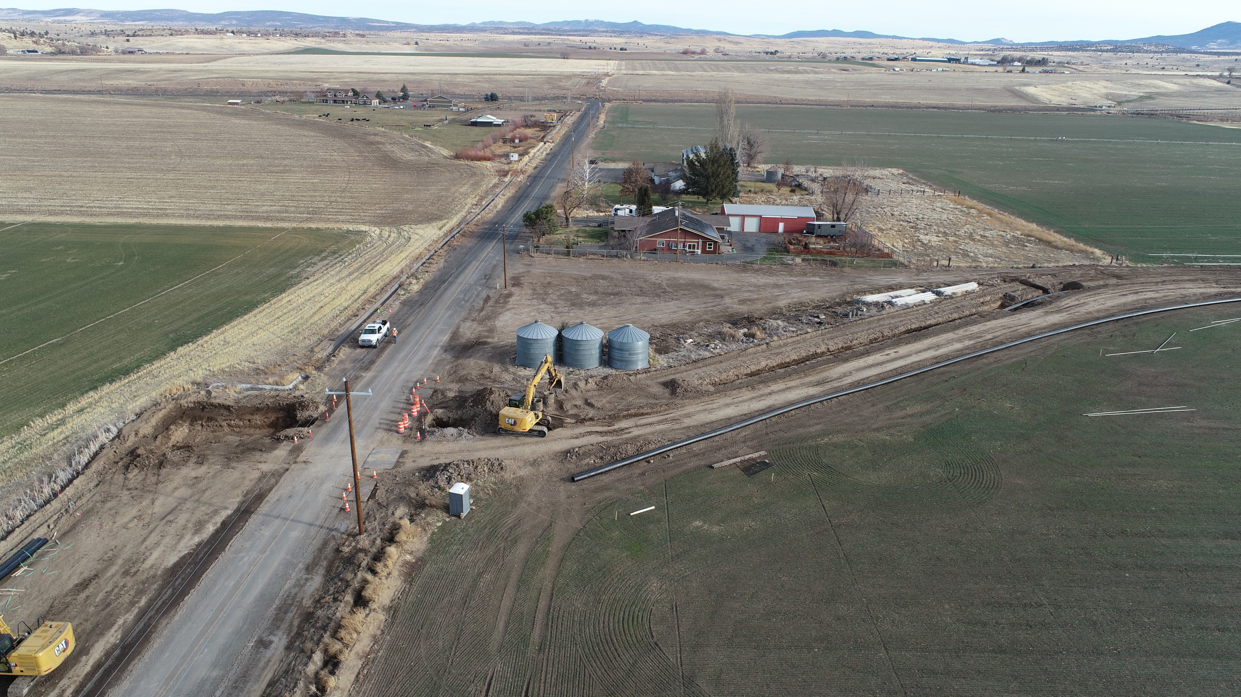

Slide 20
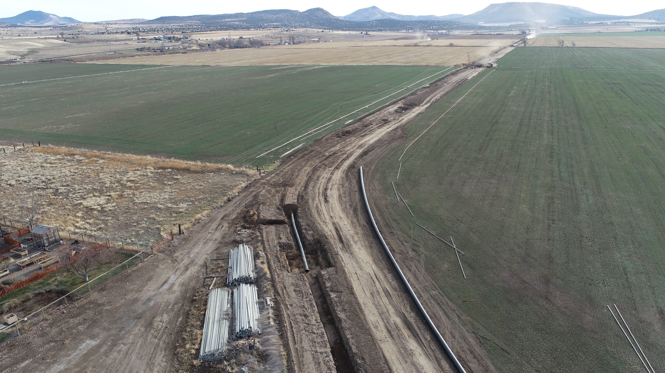
43-2 Lateral SW Highland Ln looking SE.

Slide 21
