Slide 1

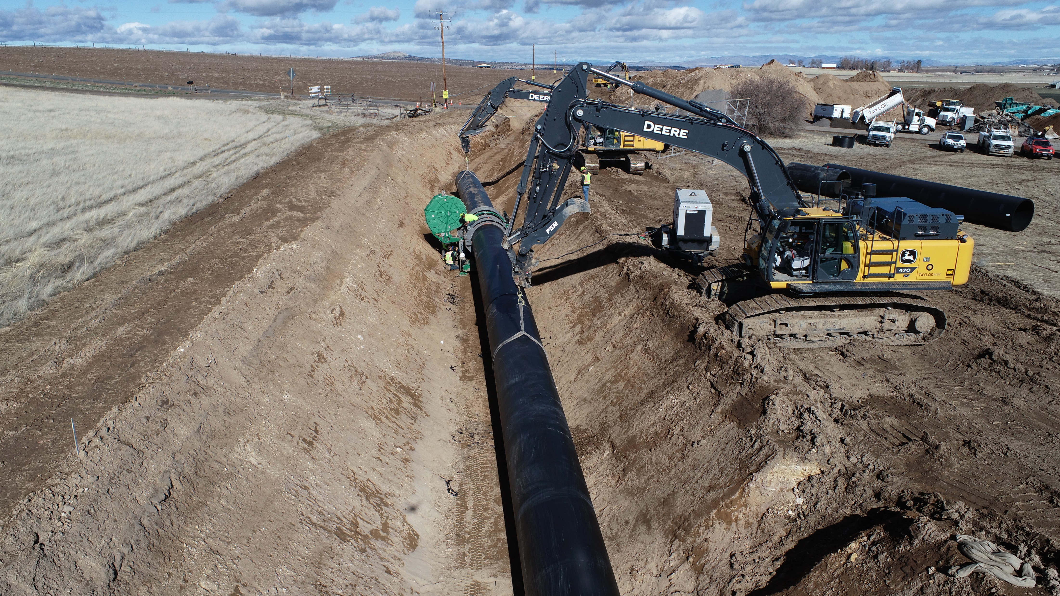

Nuid pIPE Project overview
UAS flights
03/03/25
Flown by:
Shad R. Sitz
FAA 107 Cert# 4105497
44northaviation@gmail.com
541-588-0840

Slide 2
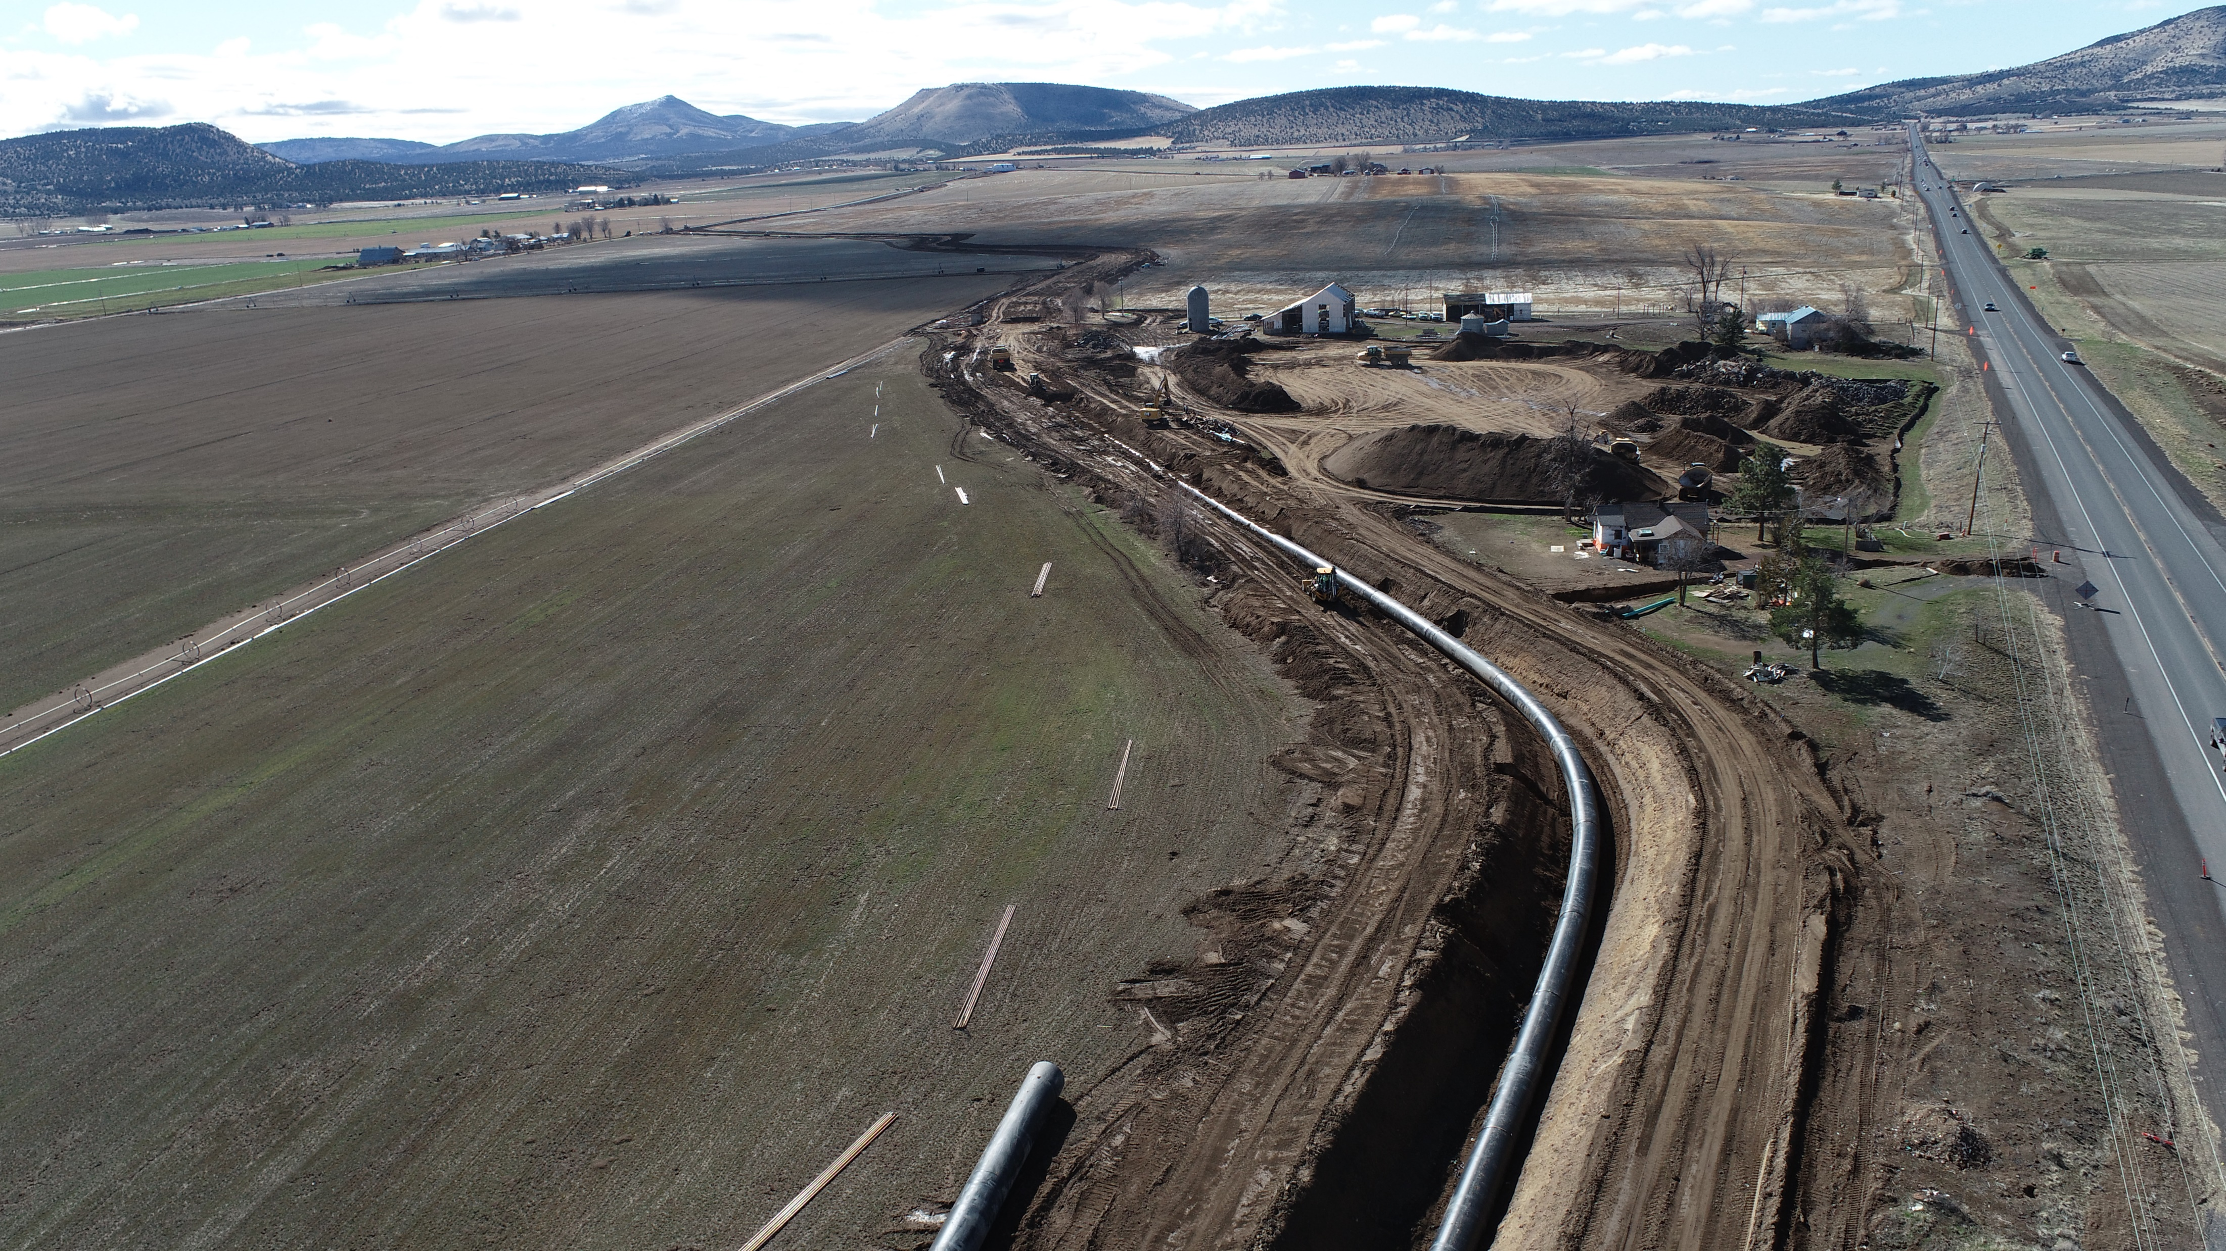
Nuid 43 Lateral Looking south

Slide 3
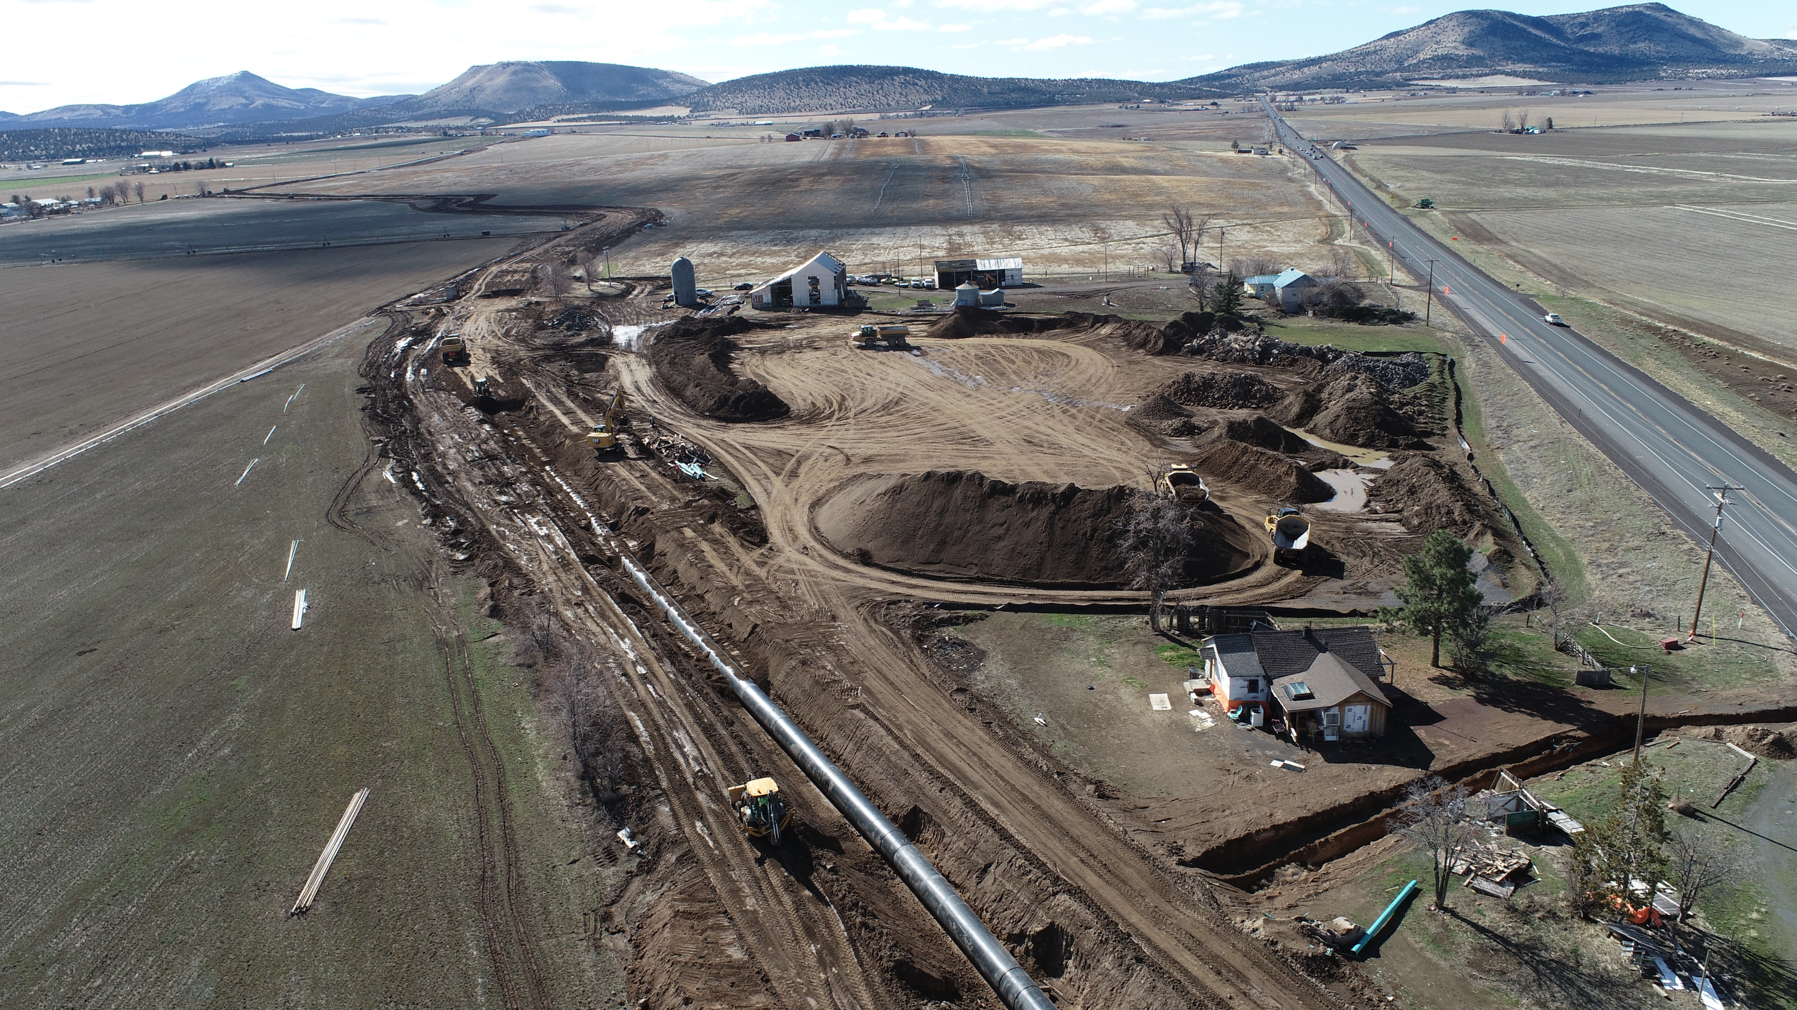

Slide 4
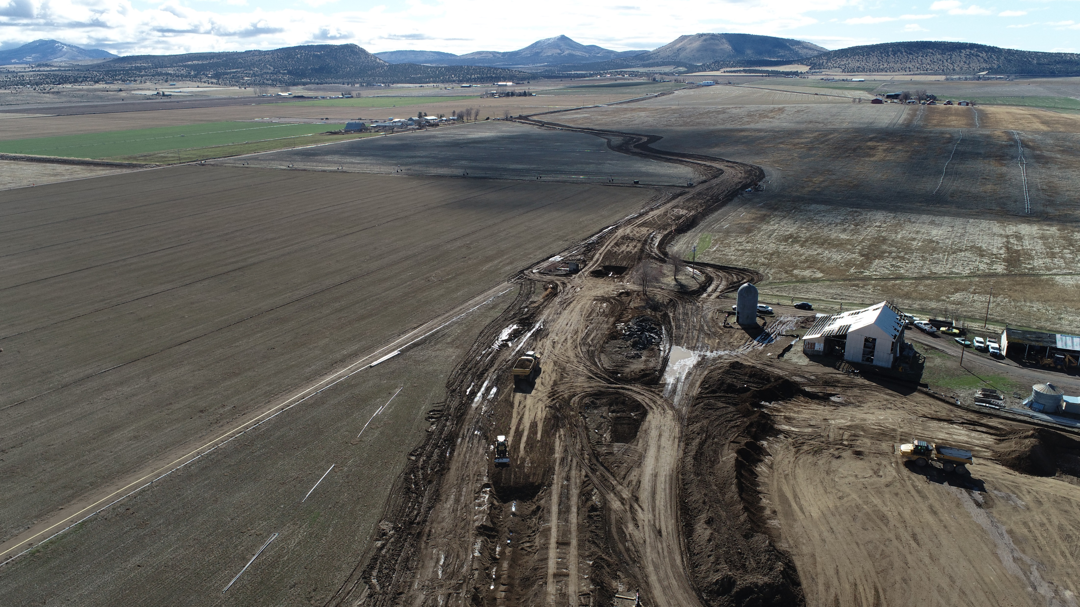

Slide 5
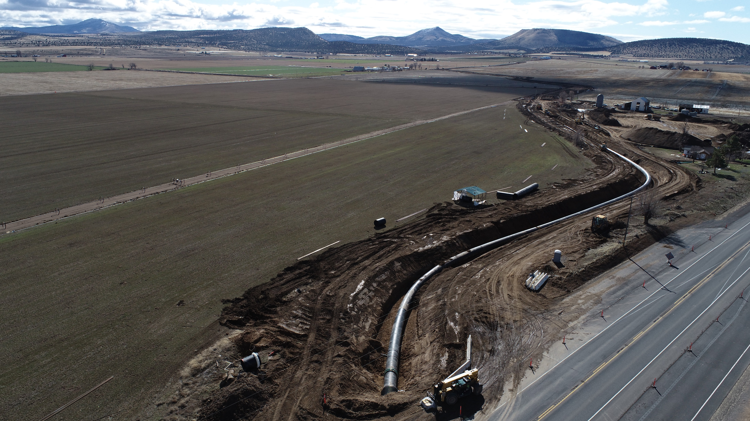

Slide 6
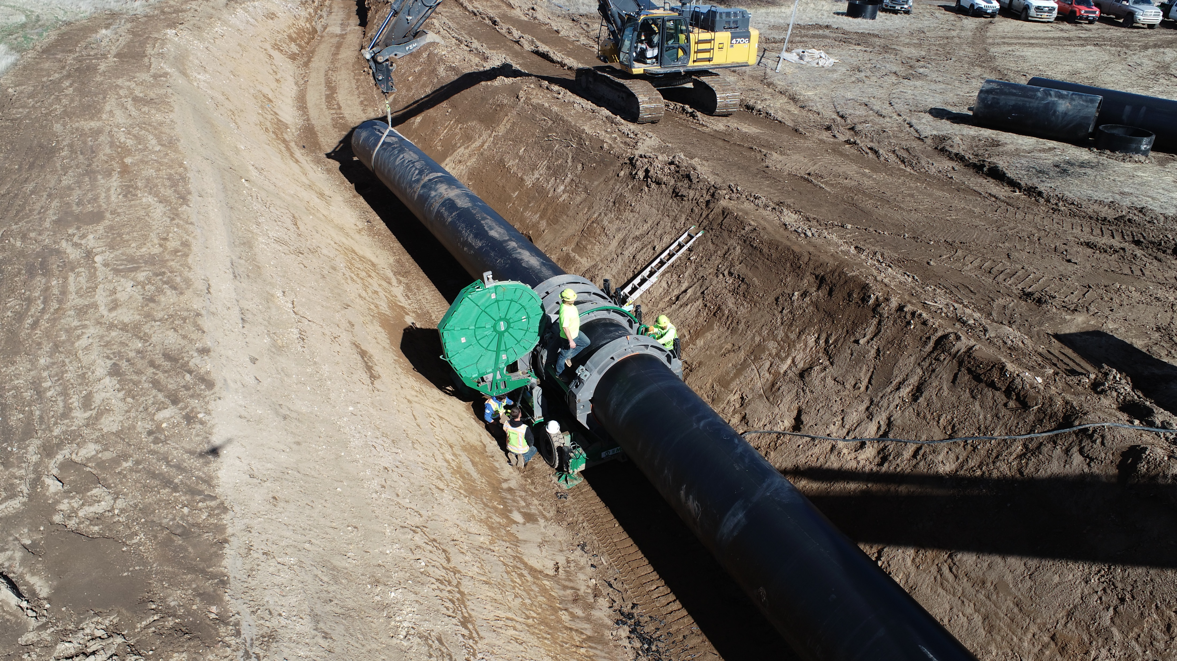

Slide 7
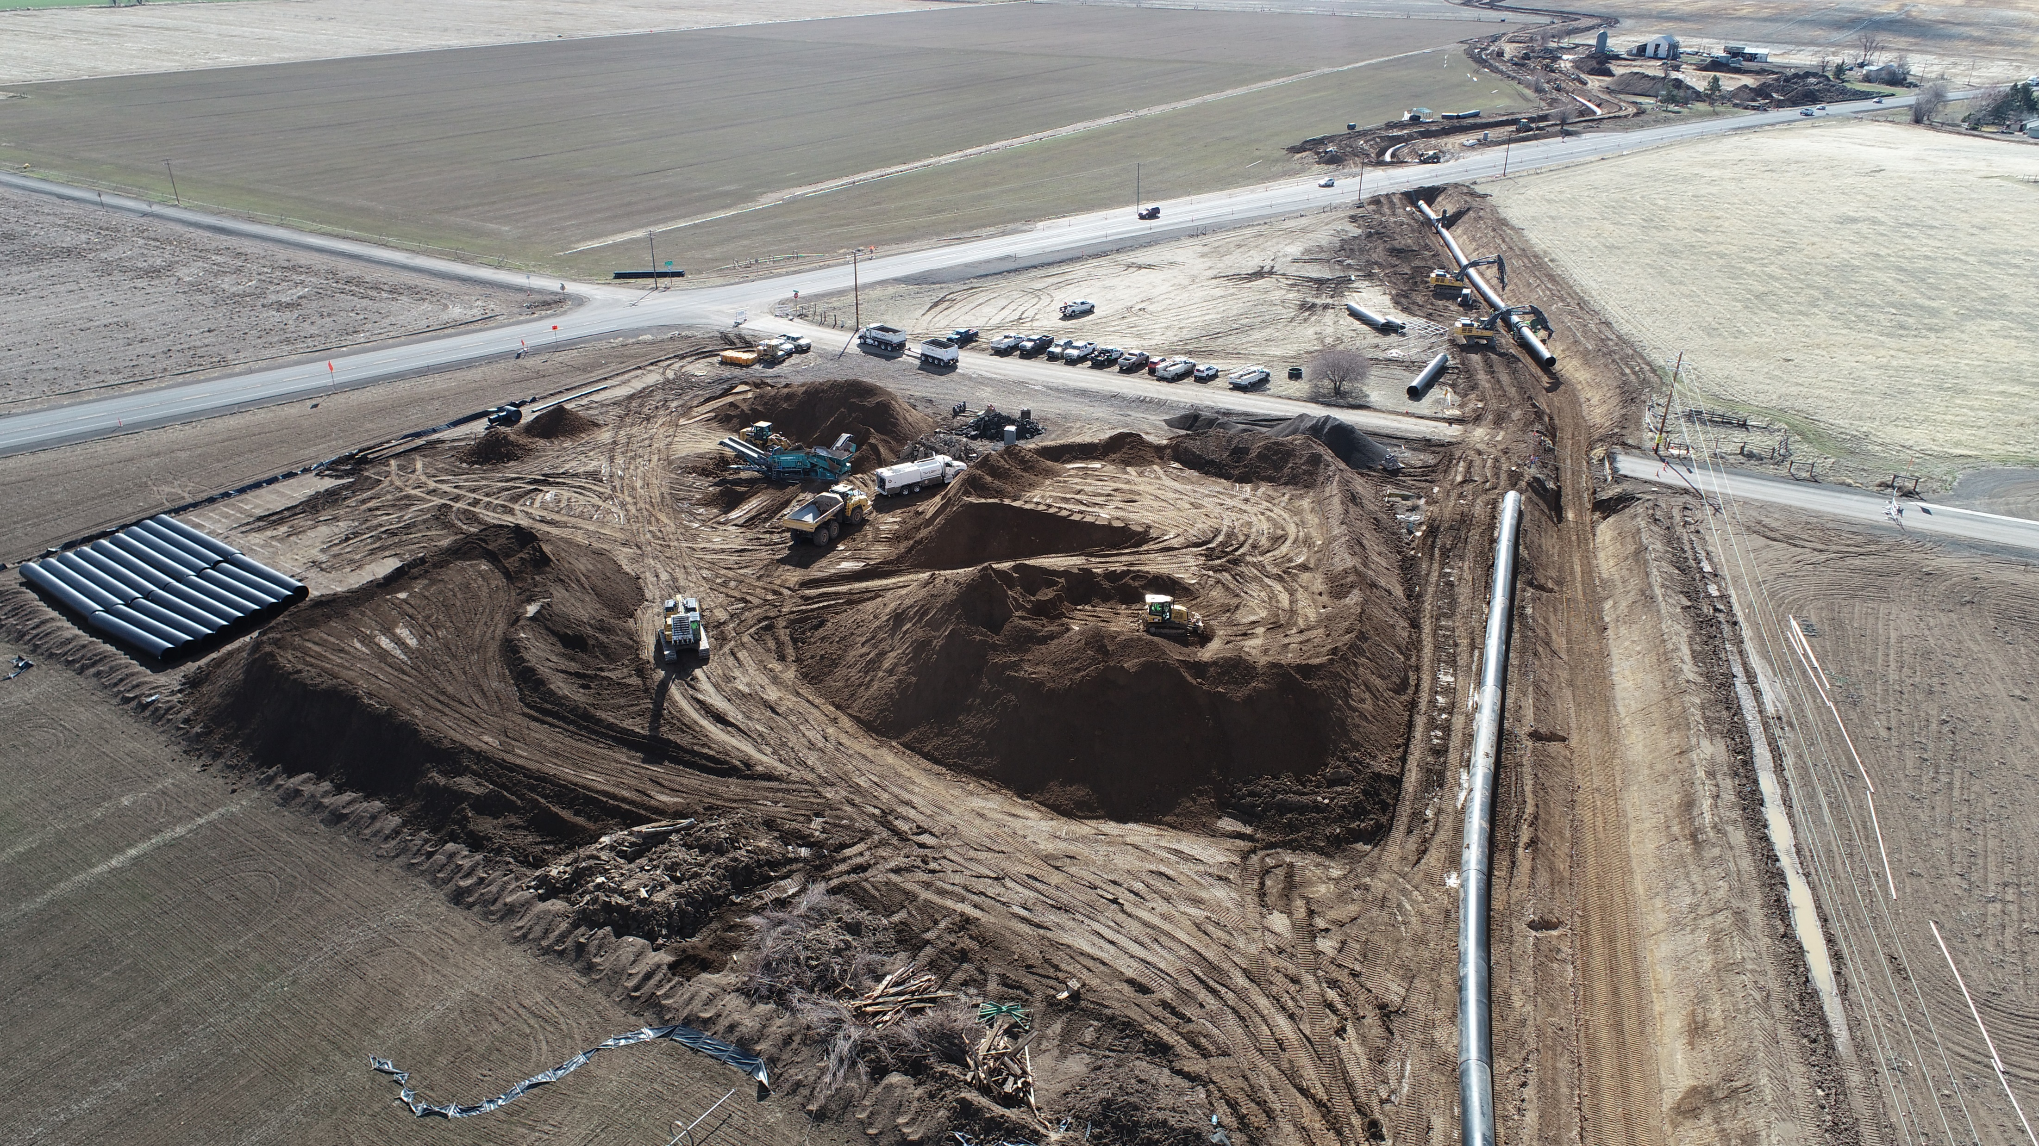

Slide 8
